Slide 1

Campground Booking Platform
Waterfall Model - Software Development Lifecycle
An SRS-driven Waterfall project — A comprehensive study in systematic software engineering methodology
Project Team
Mentor
Students:
Khush Gandhi - 612303058
Hardik Mutha - 612303066
Suswan Joglekar - 612303074
Tanmay Karad - 612303083
Faculty Mentor: Prof. Sneha Palimkar
Course: Software Engineering (CT-25001)
Semester: 5 (2025-26)

Slide 2


Problem Statement & Motivation
The camping and outdoor recreation industry faces a fragmented landscape where prospective campers and campground owners operate without a unified digital ecosystem. Currently, discovering verified campgrounds, understanding amenities, and completing secure bookings requires navigating multiple disconnected platforms, leading to inefficiency, unreliable information, and poor user experiences.
For Campers
No centralized discovery platform; difficulty verifying campground authenticity, amenities, and availability; scattered reviews across multiple sources; cumbersome booking processes.
For Campground Owners
Limited visibility and reach; manual booking management; inability to filter and approve quality bookings; lack of integrated review management and performance analytics.
Proposed Solution
A unified, role-based web platform enabling seamless discovery, booking, review, and administrative oversight - ensuring trust, efficiency, and enhanced user engagement.

Slide 3
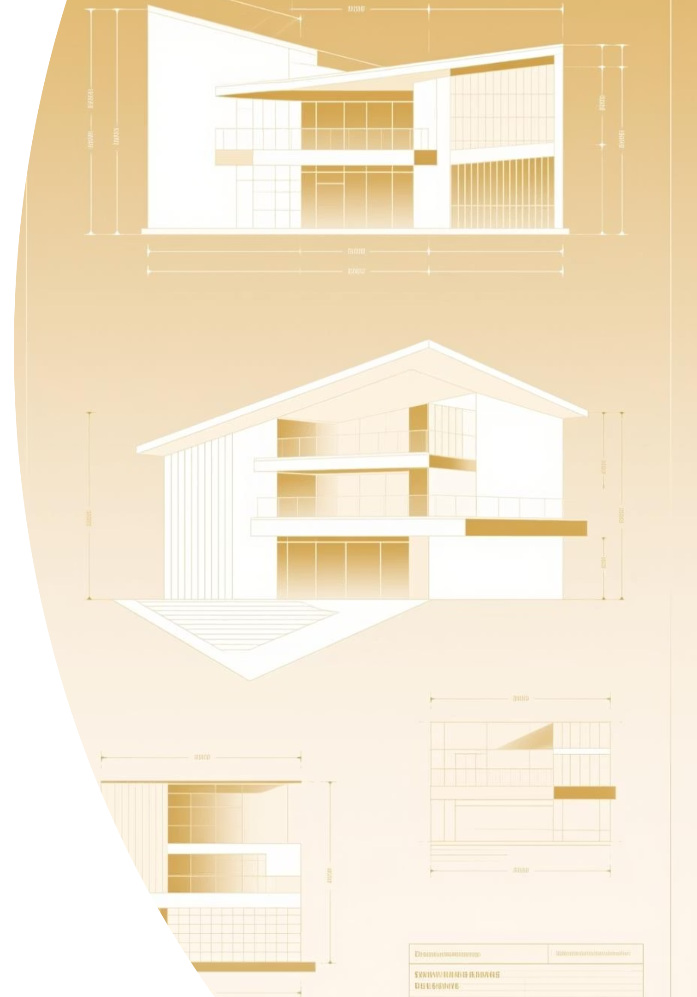
Aims & Objectives
Primary Aim
Key Objectives
To design and develop a modular, role-based web application that enables campers to discover and book verified campgrounds, campground owners to manage listings and bookings, and administrators to oversee platform integrity, with all artifacts traced through rigorous Waterfall SDLC phases.
Establish modular architecture with clear separation of concerns across presentation, application, and data layers.
Implement role-based access control (RBAC) for Admin, Owner, and User roles with distinct privileges.
Enable advanced search, filtering, and favourites functionality for enhanced user engagement.
Ensure real-time notifications for booking confirmations, status updates, and reviews.
Produce comprehensive SRS, design documents, test cases, and deployment artifacts aligned with IEEE standards.

Slide 4

Waterfall SDLC Methodology
The Waterfall model enforces a sequential, phase-gated approach to software development. Each phase must be completed and baselined before the next begins, ensuring comprehensive documentation, traceability, and formal reviews at each milestone.
01
02
03
Requirements Analysis
Design
Implementation
Comprehensive elicitation, documentation, and stakeholder review of functional and non-functional requirements; SRS baselined.
System architecture, use cases, data models, and component designs documented; design reviews conducted.
Code developed following design specifications; modular, version-controlled, and reviewed against architectural constraints.
04
05
Testing & Validation
Deployment & Maintenance
Unit, integration, system, security, and performance testing; traceability matrices ensure requirements coverage.
Release to production environment; post-deployment monitoring, user support, and iterative maintenance.
Waterfall's strength lies in clear baselines and comprehensive documentation—essential for complex systems requiring formal verification and regulatory compliance.
0

Slide 5
Requirements Analysis: Functional & Non-Functional
The Software Requirements Specification (SRS) documents all functional requirements (FR) for features and non-functional requirements (NFR) for quality attributes, ensuring comprehensive scope and measurable acceptance criteria.
Functional Requirements
Non-Functional Requirements
FR-01/02: User registration, login, and authentication via email/password.
Performance: Response time ≤ 2 seconds; support 1000+ concurrent users.
FR-03: Role assignment (Admin, Owner, User) with distinct privileges.
Security: RBAC, password encryption, SQL injection prevention.
Usability: Intuitive UI; accessible on modern browsers (Chrome, Firefox, Safari).
FR-04/05: Owner listing creation with admin approval workflow.
Reliability: 99% uptime; graceful error handling and recovery.
FR-06: Booking creation with availability checks and confirmations.
Maintainability: Code modularity, comprehensive documentation, version control.
FR-07/08: User review and rating system; owner response capability.
Portability: Cross-platform compatibility (Windows, macOS, Linux).
FR-09: Search, filter (location, dates, amenities), and favourites.
Scalability: Database indexing and caching for horizontal scaling.
FR-10: Admin reports and dashboard analytics.

Slide 6
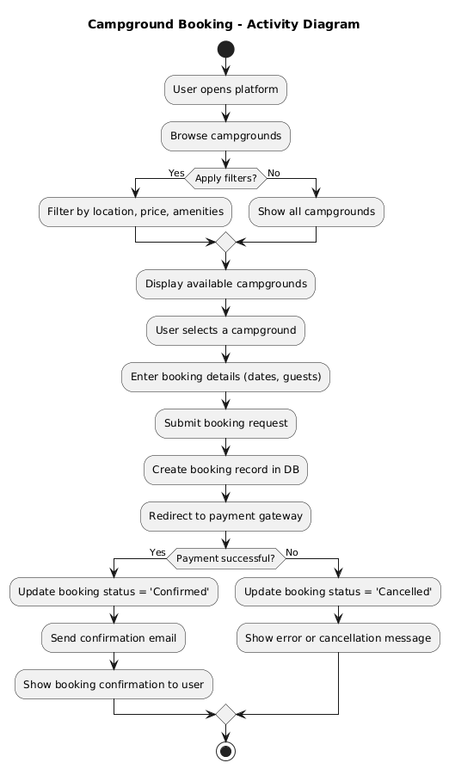
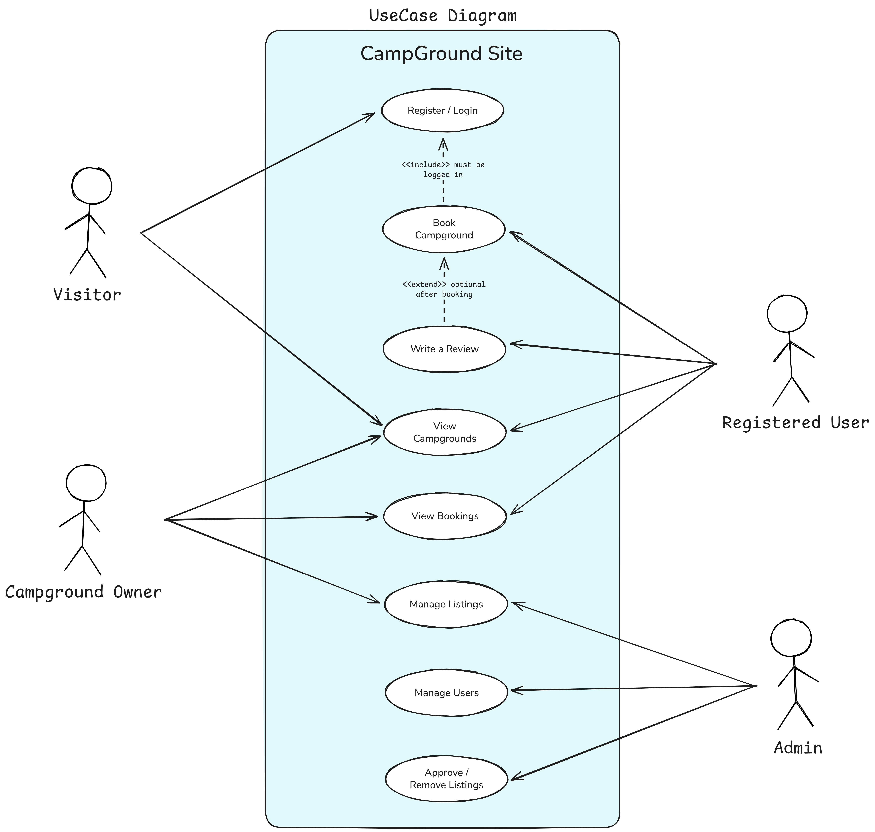

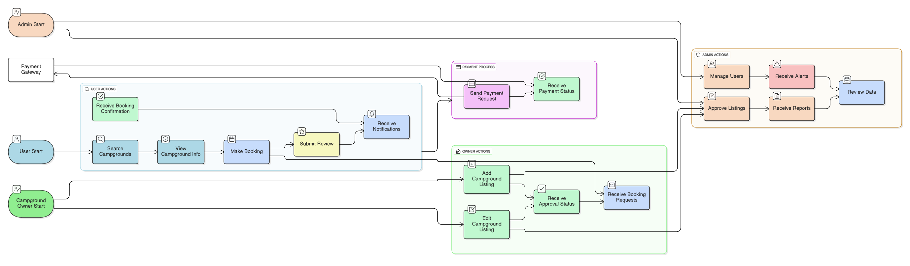
System Design: Actors, Use Cases & Data Flow
The design phase documents system behaviour through use case diagrams, activity diagrams, and data flow diagrams (DFD), specifying interactions between key actors: Visitors (unauthenticated), Registered Users (campers), Campground Owners, and Administrators. These diagrams form the foundation for implementation.
Key Insight: Separation of concerns between user-facing features, owner management, and administrative oversight ensures role-based security and streamlined workflows.

Slide 7
Data Design: Entity-Relationship Model
The ERD depicts core entities and relationships, ensuring data normalization, referential integrity, and efficient query support. Entities include Users (with roles), Campgrounds (with approval status), Bookings (with timestamps), Reviews, Amenities, and audit logs for administrative oversight.
Users: id, email, password_hash, role, created_at,
updated_at
Campgrounds: id, owner_id, name, location, description, amenities, approval_status
Bookings: id, user_id, campground_id, check_in, check_out, status, confirmation_code
Reviews: id, user_id, campground_id, rating,
comment, created_at
Amenities: id, name; junction table Campground_Amenities for many-to-many relationships

Slide 8

Implementation Architecture
A three-tier web application separates concerns across presentation, application, and data layers. The presentation layer (browser UI) communicates with a server-side application layer implementing business logic for authentication, booking workflows, approvals, and notifications, backed by a SQL database layer ensuring data persistence and integrity.
Presentation Layer
Application Layer
Data Layer
Responsive HTML/CSS/JavaScript UI; role-based dashboards for Users, Owners, and Admins; real-time notifications via WebSockets.
Modules: Auth (login, RBAC), Campground (listing, approval), Booking (creation, status), Review (submission, moderation), Admin (reports, user management). RESTful APIs with input validation and business rule enforcement.
SQL database with indexed queries; prepared statements for security; stored procedures for complex transactions; audit trails for compliance and debugging.
Technology Stack: Frontend (HTML5/CSS3/JavaScript or React); Backend (Node.js/Express, Python/Flask, or Java/Spring); Database (PostgreSQL or MySQL); Deployment (Docker/Kubernetes for scalability).

Slide 9
Testing & Validation Strategy
A comprehensive testing plan ensures quality across functional, non-functional, and security dimensions. Test cases map to requirements, and traceability matrices track coverage. The testing schedule spans the post-implementation phase, with evidence (test logs, defect reports) archived for audit.
1
Unit Testing
2
Integration Testing
Test individual modules (Auth, Booking, Review) in isolation; achieve ≥80% code coverage.
Verify inter-module communication; test end-to-end workflows such as booking creation triggering notifications and admin approvals.
3
System & Performance Testing
4
Security & Compliance Testing
Validate system against NFRs: response times ≤2s under load; concurrent user stress tests; database query optimization.
SQL injection, role-based access control validation.
Deliverable: Comprehensive test case document, test execution logs, and traceability matrix linking test cases to requirements (FR/NFR).

Slide 10
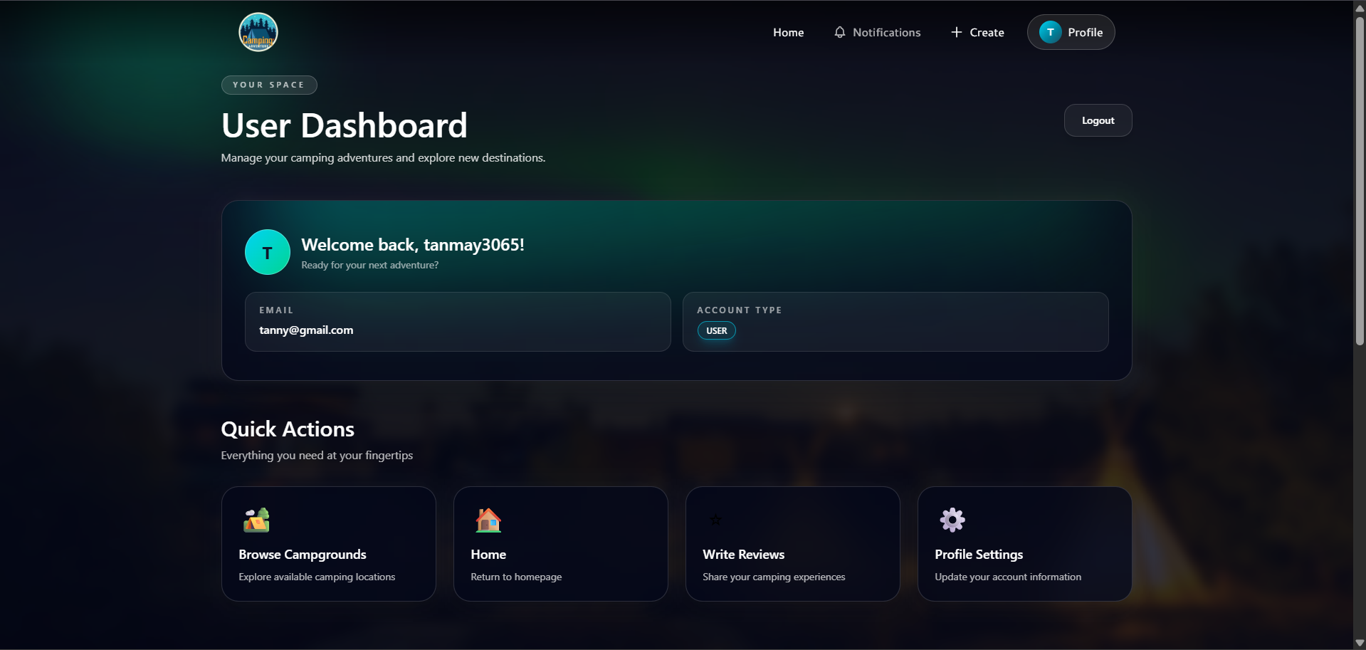
Results, Deployment & Future Enhancements
The implemented platform successfully demonstrates core functionality through user interface prototypes, booking workflows, and admin dashboards. Waterfall's rigorous documentation and traceability ensure maintainability and auditability. Future enhancements include real payment gateway integration, advanced availability forecasting, WCAG 2.2 accessibility compliance, and multi-tenant scalability for regional expansion.
Proposed Future Work
Integration with real payment gateways (Stripe, PayPal) and PCI-DSS compliance.
WCAG 2.2 accessibility enhancements for inclusive user experience.
Horizontal scaling via microservices and API gateway patterns.
Mobile application (iOS/Android) for on-the-go bookings and management.

